Slide 1
LTEL Designee Training
LAUSD
Master Plan for English Learners
Local District West
12/06/17

Slide 2
Objectives
Review the agreement made between LAUSD and the Office for Civil Rights
Define Long Term English Learners (LTELs) and Potential Long Term English Learners (P-LTELs)
Understand the roles and responsibilities of the LTEL Designee
Explore and use district’s monitoring tools and resources

Slide 3
Inclusion: “Like Me”
Stand up if…
You are an EL Designee
You are an administrator
You are a Title III Coach
You are a counselor
You are a classroom teacher
You are another out of classroom support staff (Coach, coordinator, A.P., etc.)
You have taught English Learners
You learned English as a second language
You learned a second language
You make a difference in the lives of students

Slide 4
Professional Reading
Meeting the Unique Needs of Long Term English Language Learners: A Guide for Educators --“Eight Characteristics of Effective Educators”
Form quads and number off from 1 to 4 for modified jigsaw.
Number 1s will read characteristics 1 and 2 (page 24 & 25)
Number 2s will read characteristics 3 and 4 (page 25 & 26)
Number 3s will read characteristics 5 and 6 (page 27 & 28)
Number 4s will read characteristics 7 and 8 (page 28 & 29)
Be prepared to share out to your group of four and the larger group

Slide 5
Numbered Heads Together

Slide 6
LAUSD’s definition of LTELs
Long Term English Learners
Before Fall, 2016:
Master Plan p. 65: “defined in LAUSD as those EL students who have completed five full years in U.S. schools (i.e. beginning their sixth year and beyond) without meeting the criteria for reclassification.”
Fall, 2016:
EL Dashboard Job Aid: “6th-12th grade students with more than 5.0 years as an English Learner”

Slide 7
LAUSD’s definition of P-LTELs
Potential Long Term English Learners
Fall, 2016:
EL Dashboard Job Aid:
3rd – 5th grade student with more than 4.0 years as an EL
6th – 12th grade student with 4.0-5.0 years as an EL

Slide 8
LTELs in Ed. Code
Ed. Code 313.2 (LTELs)
(a) The department shall annually ascertain the number of pupils in each school district and school, including a school that is within the jurisdiction of a county office of education and a charter school, who are, or are at risk of becoming, long-term English learners…
CDE defines LTELs as having been an English Learner for more than six years.

Slide 9
LTELs with IEPs (same for P-LTELs)
LTEL students with disabilities who have an IEP need to have their progress monitored on a consistent and timely basis
The IEP Team will monitoring the LTEL students’ progress
The LTEL Student Goal Sheet will not be considered necessary documentation for any LTEL who currently has an IEP
The IEP case manager may consult with the LTEL Designee
Note: Because students with 504 plans do not have IEPs, LTEL Designee will monitor LTEL students with 504 plans.

Slide 10
BUL-6266.0 LTEL Policy

Slide 11
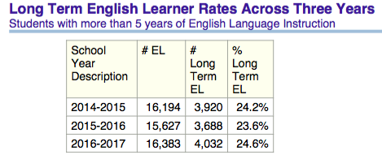
Local District West Data

Slide 12
Table Talk
How many LTELs or P-LTELs are at your site?
What patterns do you see?
How has your school addressed some these issues?
Notes:
Be aware of accepting approximation of numbers based on MiSiS concerns.

Slide 13
Master Plan
Part of the U.S. Department of Education’s Office for Civil Rights agreement (October 2011)
Board Approved in June 2012
Stakeholder groups involved:
AALA, UTLA, Parents, Experts, Consultants
Note: Master Plan is currently being revised this year

Slide 14
Master Plan
Page 63 (Middle Schools)
Page 66 (High Schools)
“All middle school LTELs are designated a specific counselor, teacher specialist or faculty member to monitor their language status, test, goals for meeting grade level standards and reclassification. All LTELs and their parents meet at least twice yearly with the designated faculty member to review current language status, program placement, test results and goals for attaining reclassification criteria and accelerated academic progress targets.”
“All LTELs in grades 9-12 are designated a counselor, teacher specialist or faculty member to monitor their language status, test, goals for meeting grade level standards and reclassification. All LTEL students and their parents meet at least twice yearly with this designated faculty member to review current language status, program placement, test results and goals for attaining reclassification criteria and accelerated academic progress targets.”

Slide 15
LD West:
All elementary school LTELs are designated a specific teacher or faculty member to monitor their language status, test, goals for meeting grade level standards and reclassification. All LTELs and their parents meet at least twice yearly with the designated faculty member to review current language status, program placement, test results and goals for attaining reclassification criteria and accelerated academic progress targets.
LD West:
In elementary schools, all 4th and 5th grade P-LTELs are designated a specific teacher or faculty member to monitor their language status, test, goals for meeting grade level standards and reclassification. All P-LTELs and their parents meet at least once yearly with the designated faculty member to review current language status, program placement, test results and goals for attaining reclassification criteria and accelerated academic progress targets.

Slide 16
Grab your phone… Get up... Get into groups of three... Decide on a group name... Go to kahoot.it
Reclassification Challenge

Slide 17
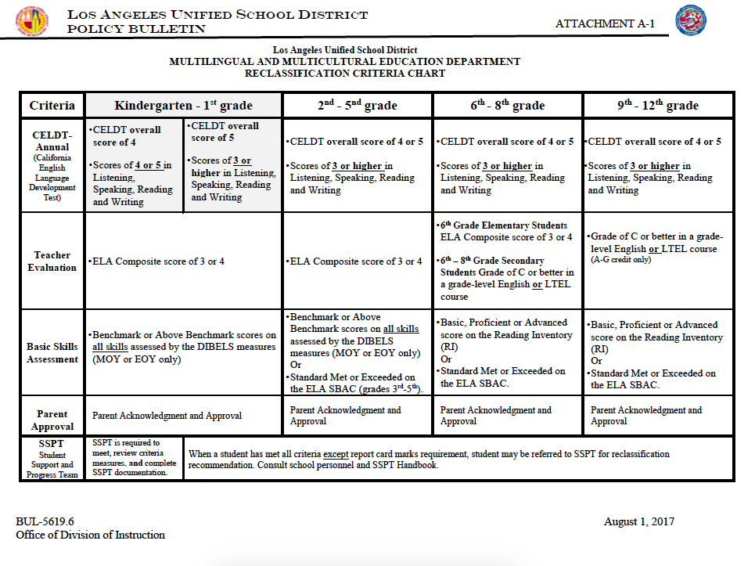
Reclassification of Eligible Students BUL-5619.4
A B Share

Slide 18
LTEL Designee Roles & Responsibilities
Monitors each LTEL’s/P-LTEL’s:
Language status
Test results
Goals for meeting grade level standards
Progress towards reclassification
Meet with students and parents twice a year for LTELs and once a year for P-LTELs in 4th and 5th grade:
Language status
Program placement
Test results
Goals for attaining reclassification criteria and accelerate academic progress targets
LTEL Designee will be a standing member of the Student Support & Progress Team (SSPT)
Maintain documentation of the individual conferences and meetings
Notes:
Notes for Presenter:
Language status = language classification (LEP) for five years or more, English Learners (EL), Long Term English Learners (LTEL)
Test results = CELDT, CST, CMA, LPA, CAHSEE
Goals for meeting grade level standards/academic progress targets = grading, portfolios, benchmarks (proficiency rates, minimum progress expectations, etc.)
Progress toward reclassification = reclassification criteria
Program Placement = Structured English Immersion (EI), SI (Special Ed. SEI), Mainstream, Dual Language (DL), Waiver to Basic (WB), P/PRP (Preparing to Reclassify), Sheltered (SH)

Slide 19
Tools for Monitoring LTEL Data

Slide 20
EL Dashboard
Accessing language status, test results, program placement, progress toward reclassification

Slide 21
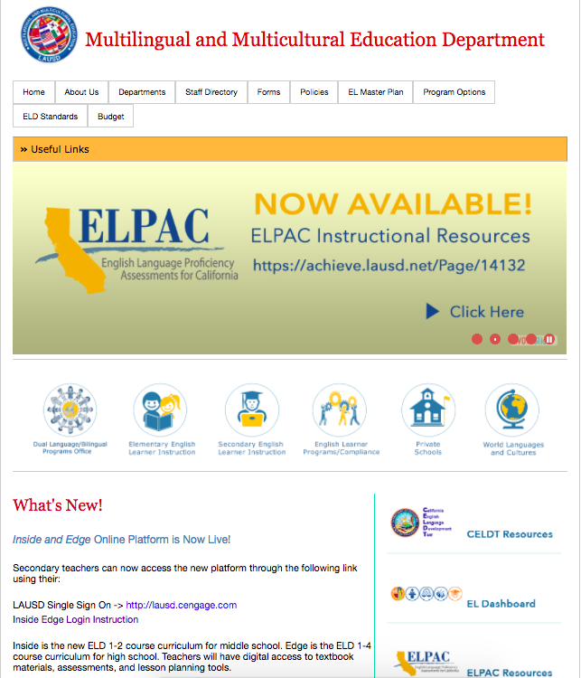
Go to mmed.lausd.net to access the EL Dashboard or go to focus.lausd.net. Principals, EL Designees and Title III Coaches have access to the EL Dashboard.

Slide 22
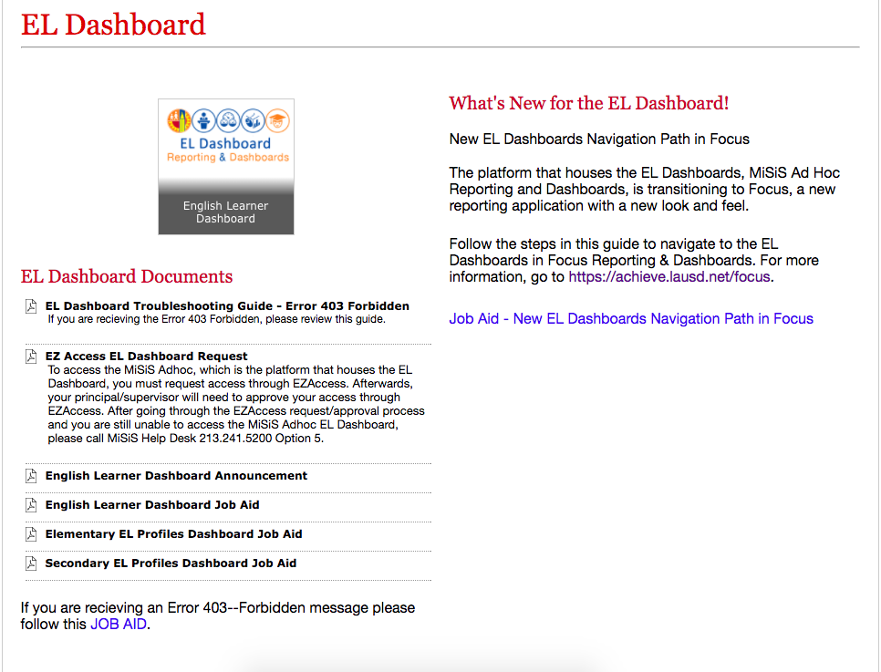
If you are going through mmed.lausd.net, click on English Learner Dashboard and log in to access your school’s EL Dashboard.

Slide 23
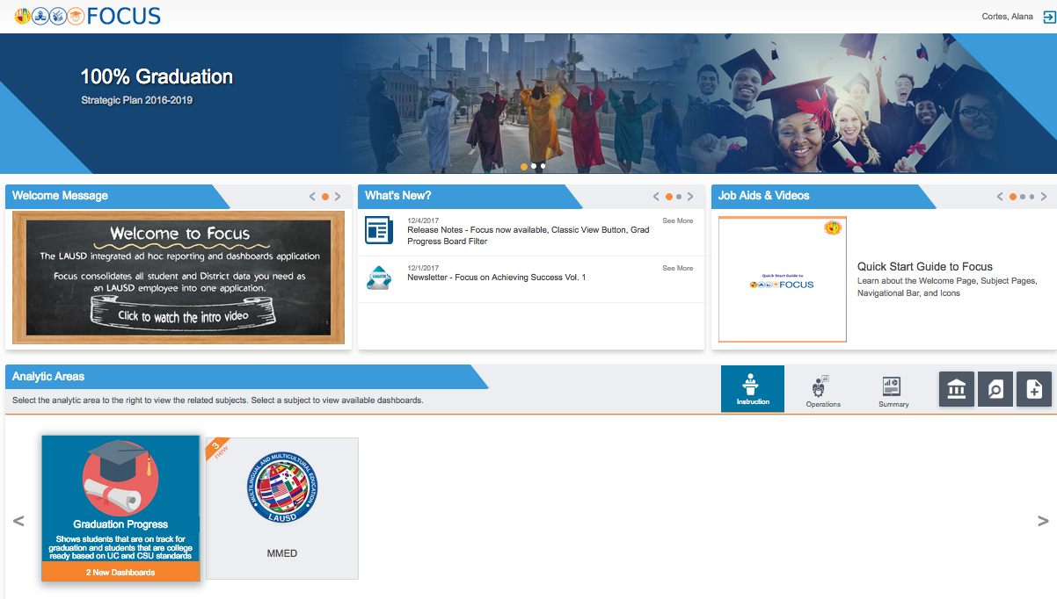
focus.lausd.net
Click on the MMED tile at the bottom of the screen.
Click on MMED Tile
Notes:
2 minutes

Slide 24
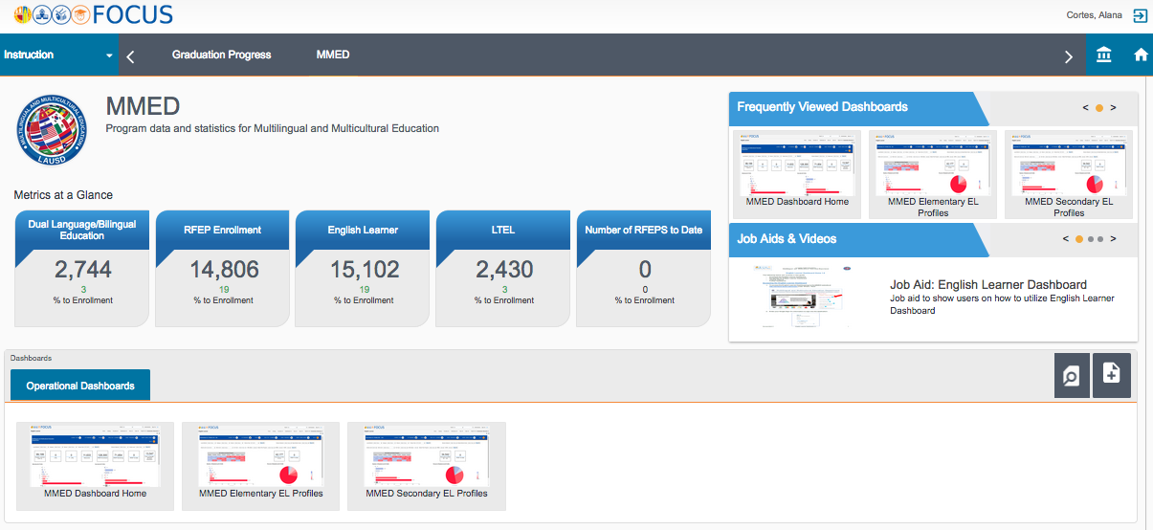
Data Changes on the EL Dashboard!!!
Click on the “MMED Dashboard Home” in the “Operational Dashboards” at the bottom of the screen.
Click on MMED Dashboard Home
Notes:
1 minute

Slide 25
According to the EL Dashboard:
How many LTELs do you have?
How many P-LTELs do you have?

Slide 26
Access Your School’s EL Profiles
Hover over “English Learner” in the bar at the top.
Click on “Elementary EL Profiles” (for 2nd – 5th grade ELs) or ” Secondary EL Profiles” (for 6th-12th grade ELs).

Slide 27
EL Dashboard

Slide 28
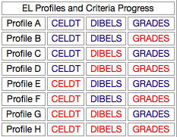
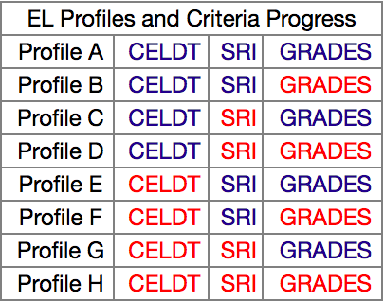
EL Profiles

Slide 29
Elementary Profile C Roster
Notes:
Update profile c screen shot (sbac)

Slide 30
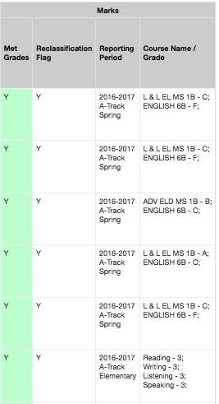
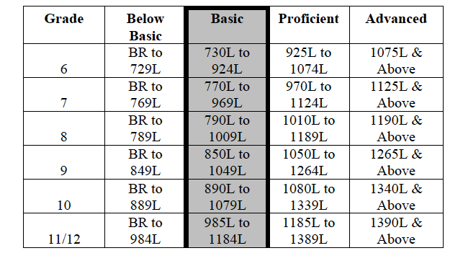
Secondary Profile C Roster

Slide 31
My Integrated Student Information System (MiSiS)
Language status, test results, program placement

Slide 32
MiSiS: EL Rosters
Reports

Slide 33
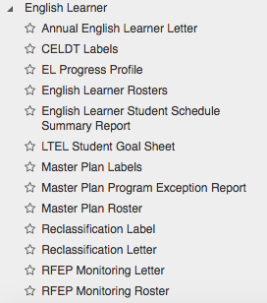
MiSiS: English Learner Rosters
English Learner:
English Learner Rosters

Slide 34
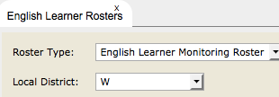
MiSiS: EL Rosters
Select Roster

Slide 35
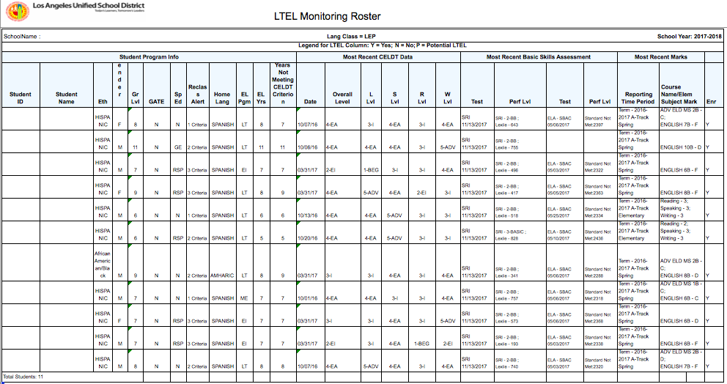
LTEL Monitoring Roster
Notes:
Check and possibly update slide

Slide 36
LTEL Monitoring Roster-Secondary

Slide 37
LTEL Monitoring Roster-Elementary

Slide 38
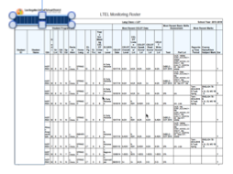
Guided Practice
Look at your sample LTEL Monitoring Roster
Which students would you highlight? Why?
Discuss with an elbow partner.
Handout: Back to Back (Elementary/Secondary)

Slide 39
Accessing ELD Progress Profile in MiSiS

Slide 40
MiSiS: Accessing EL Progress Profile
Reports

Slide 41
MiSiS: EL Progress Profile
English Learner:
EL Progress Profile

Slide 42
Accessing EL Progress Profile
Select parameters
& click view

Slide 43
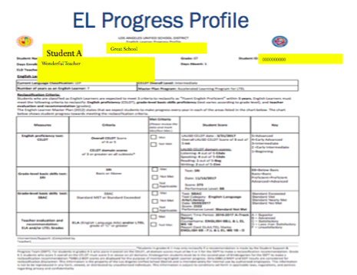

Slide 44
Accessing LTEL Student Goal Sheet in MiSiS

Slide 45
MiSiS: LTEL Student Goal Sheet
English Learner:
LTEL Student Goal Sheet

Slide 46
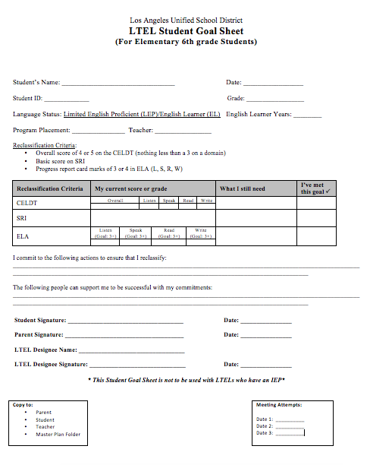
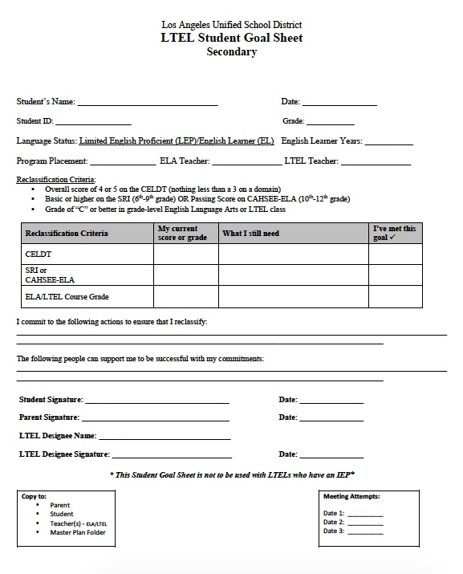
LTEL Student Goal Sheet Elementary (6th Grade) and Secondary (6th-12th Grade)

Slide 47
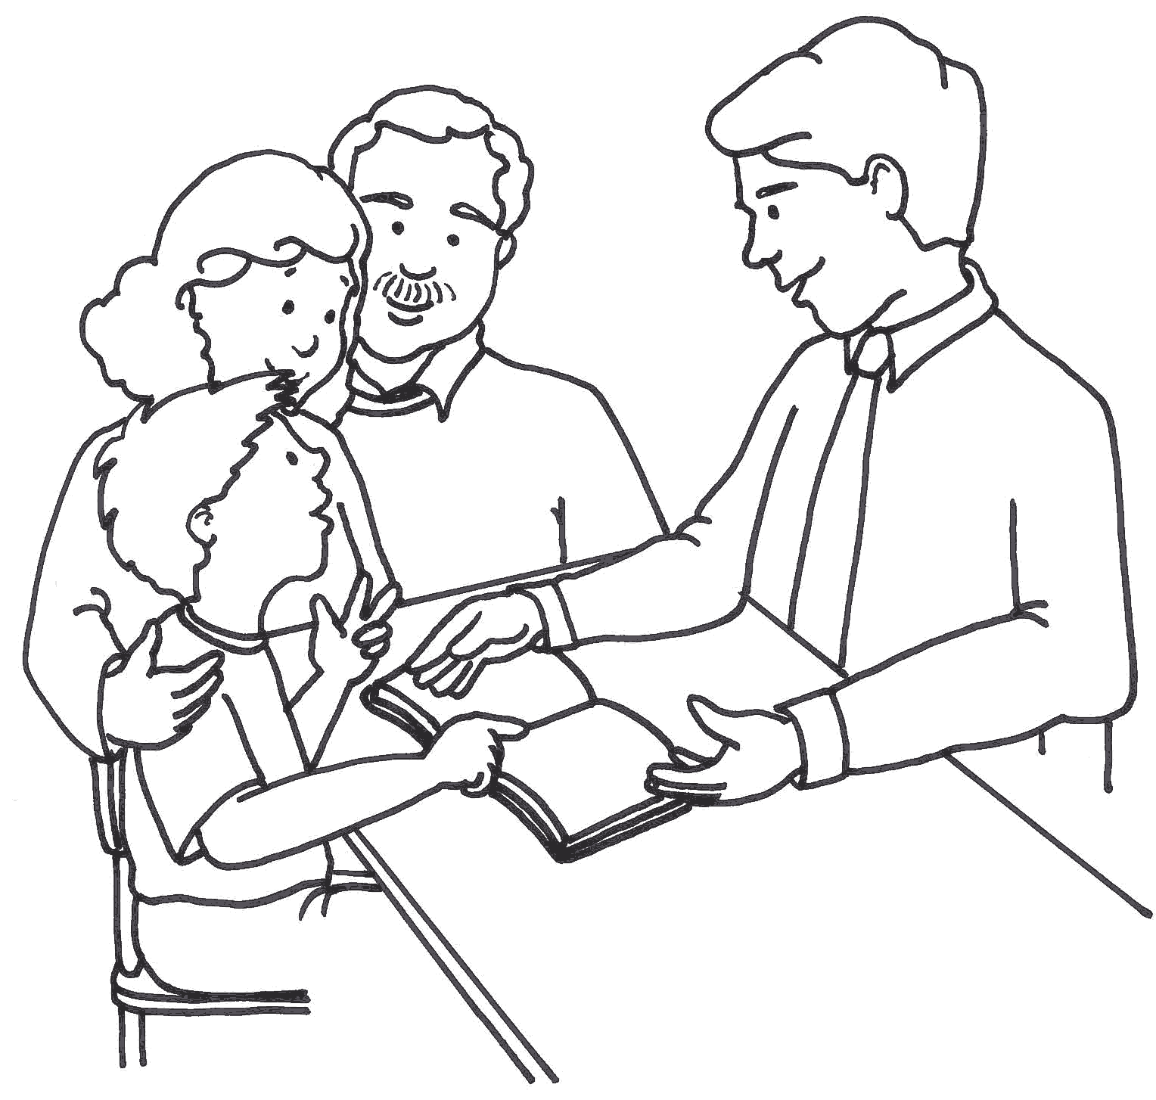
LTEL and P-LTEL Student-Parent Conference

Slide 48
Preparing for the parent/student conference
Meet with LTEL students and parents twice a year (6th-12th) or P-LTEL students and parents once a year (4th – 5th ) to review:
Language status
Program placement
Test results
Goals for attaining reclassification criteria and accelerate academic progress targets

Slide 49
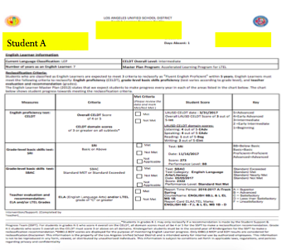
Conference Practice
What information would you pull from the EL Progress Profile to share with students and parents?
What would you say?
Practice with a partner
Share out

Slide 50
LTEL and P-LTEL Meeting Structures
Individual Conferences
Group
Meetings
Large LTEL population
Small or Large LTEL population
Meet individually with students and/or parents together or separately if needed
Meet with students and/or parents together or separately in groups if needed

Slide 51
Using Existing Structures
Individual
Conferences
Group
Meetings
LTEL Designee Team Members:
Counselors, Department Chairs, Teachers, Coordinators, Administrators, Coaches
LTEL Designee Team Members:
Counselors, Department Chairs, Teachers, Coordinators , Administrators, Coaches
-During parent/teacher conferences
-Individual Graduation Plan meeting
-Classroom presentation
-Existing small group parent meetings (i.e. before or after student performances, before or after ELAC, etc.)

Slide 52
LTEL and P-LTEL Student-Parent Meetings
In the event that a parent does not attend a meeting, schools should document a minimum of 3 attempts using at least 2 different methods.

Slide 53
Table Talk
What are existing structures at your school site you could optimize to support the LTEL/P-LTEL parent/student meetings?
What are some other structures you could put in place to facilitate these meetings?

Slide 54
BUL-6266.0 LTEL Designees’ Roles and Responsibilities

Slide 55
Roles and Responsibilities

Slide 56
Documentation: LTEL Designee Form

Slide 57
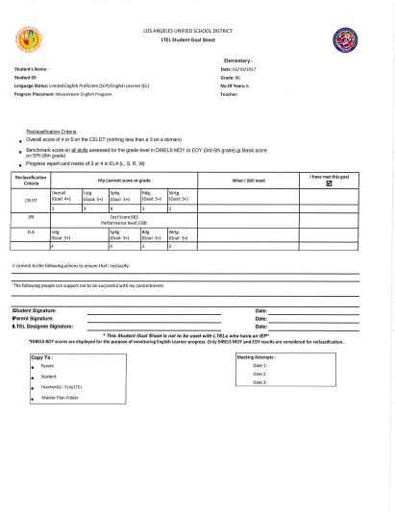
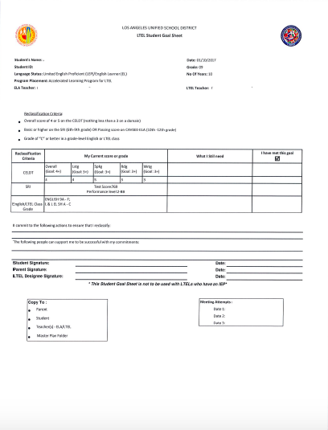
Documentation: LTEL Student Goal Sheet Elementary and Secondary from MiSiS

Slide 58
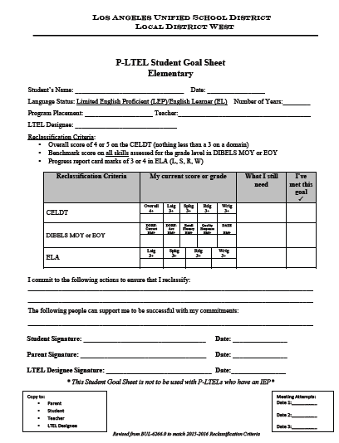
Documentation: LD West P-LTEL Student Goal Sheet Elementary

Slide 59
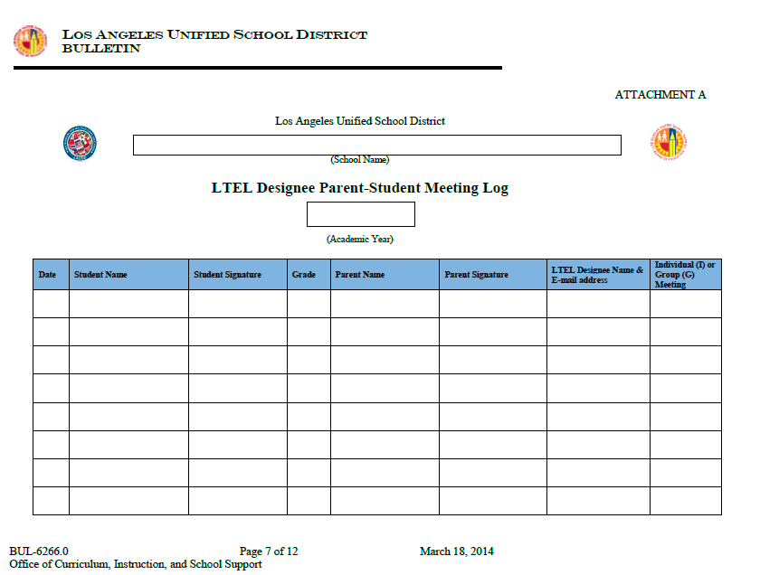
Documentation: Meeting Log

Slide 60
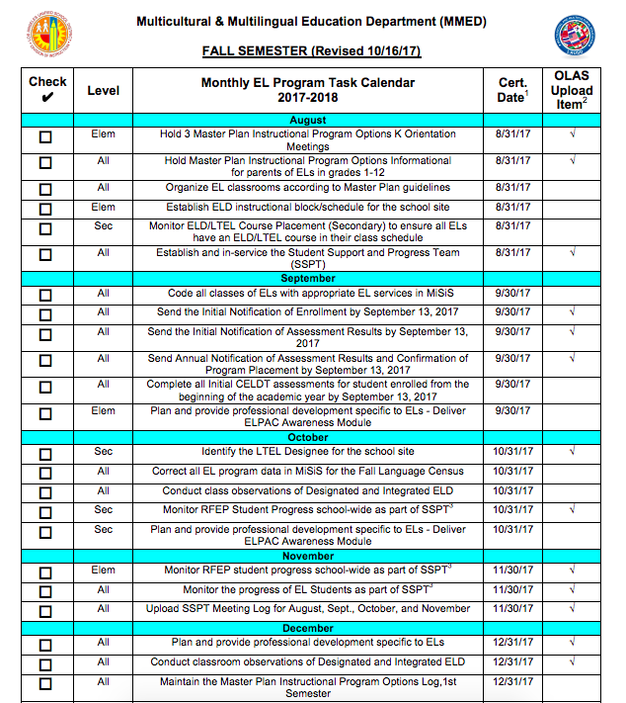
Instructional Online Accountability System
Certification:
OCT -LTEL Designee Form
JAN –Monitor LTEL Student Progress-Parent Meeting #1
APRIL –Monitor LTEL Student Progress -Parent Meeting #2
Upload:
LTEL Designee Form
Annotated LTEL Monitoring Roster that identifies all LTELs*
Meeting announcement sent to parents
2-3 completed and signed LTEL Student Goal Sheets*
*White out or black out student names

Slide 61
2017-18 Goals
Monitor all LTELs or 4th and 5th Grade P-LTELs without an IEP
All LTEL students and their parents will meet twice with the LTEL Designee (LTELs without an IEP)
All 4th and 5th Grade P-LTEL students and their parents will meet once with the LTEL Designee (P-LTELs without an IEP
LTEL Designee must be an active participant of the SSPT Meetings

Slide 62
Objectives
Review the agreement made between LAUSD and the Office for Civil Rights
Define Long Term English Learners (LTELs) and Potential Long Term English Learners (P-LTELs)
Understand the roles and responsibilities of the LTEL Designee
Explore and use district’s monitoring tools and resources

